Slide 1
Hardware

Slide 2
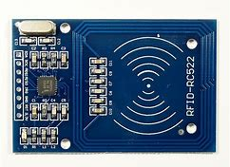
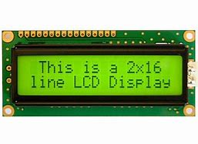
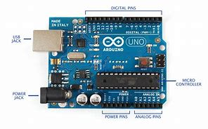
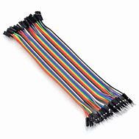

Components
MFRC-522 RFID Reader
16*2 LCD Display
Arduino UNO
Breadboard
Jumper Wires

Slide 3
Hardware components and Cost Analysis
COMPONENTS | PRICES
ARDUINO UNO ATMEGA328P | Rs. 380
RFID-RC522 Reader | Rs. 200
RFID Card | -
LCD 16*2 Display/OLED Display | Rs. 150
Jumper Wires | 2 Rs./ piece
Bread Board | Rs. 110
USB Cable | Rs. 50
10K Potentiometer/ Resistors | Rs. 10
Total | Rs. 930 --950

Slide 4
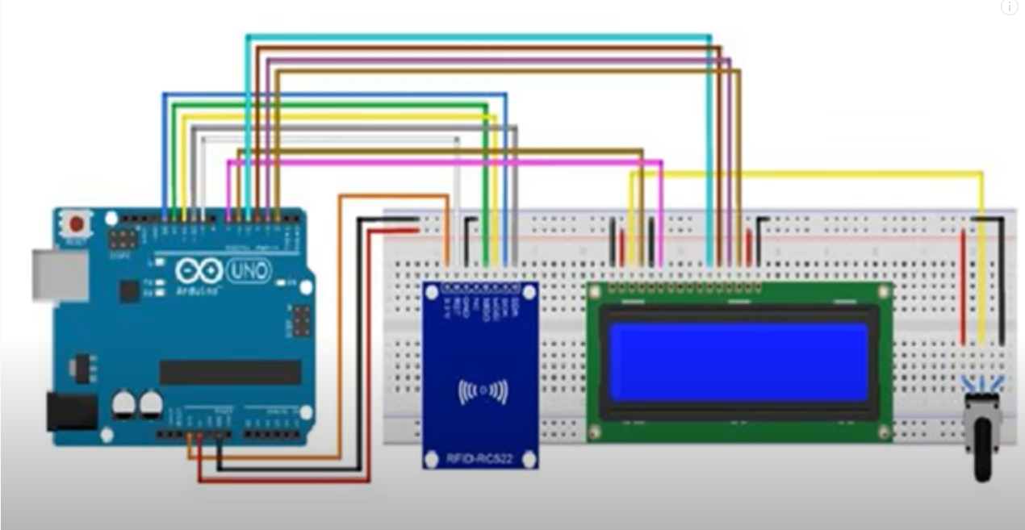
HARDWARE CONFIGURATION
Connection Diagram of Components

Slide 5
Connections of components
Arduino | Conecction
Arduino pin 1 | --------------
Arduino pin 2 | LCD - D7(pin 14)
Arduino pin 3 | LCD – A(pin 15)
Arduino pin 4 | LCD - D5(pin 12)
Arduino pin 5 | RFID - RST
Arduino pin 6 | LCD - D4(pin 11)
Arduino pin 7 | LCD – E(pin 6)
Arduino pin 8 | ---------------
Arduino pin 9 | LCD -RS pin 4
Arduino pin 10 | RFID – SDA
Arduino pin 11 | RFID – MOSI
Arduino pin 12 | RFID – MISO
Arduino pin 13 | RFID – SCK
Arduino GND | RFID – GND, LCD -R/W pin 5, LCD -GND pin 1
Arduino GND | LCD -K (pin 16) (via 220 ohm resistor), LCD -VO (pin 3) (via1k ohm)
Arduino 3.3V | RFID – 3.3V
Arduino 5V | LCD -D6(pin 13), LCD – VCC(pin 2)

Slide 6
Software

Slide 7
About Software
Arduino language is used for programming Arduino. The Arduino used here is Arduino UNO. Arduino IDE is required for developing code and uploading to Arduino board. Following is the code for the project. Liquid Crystal Display(LCD), SPI, MFRC522 these Libraries are required for code. Functions of these libraries and some basic functions like delay, break and loops and conditional statements are used in the code.

Slide 8
Arduino Code
#include <LiquidCrystal.h>
#include <SPI.h>
#include <MFRC522.h>
#define SS_PIN 10
#define RST_PIN 9
MFRC522 mfrc522(SS_PIN, RST_PIN);
LiquidCrystal lcd(9, 7, 6, 4, 3, 2);
String studentUIDArray[]={"B1 3C CB 20","81 1B 00 1B"};
String bookUIDArray[]={"09 6E 99 6E","86 12 C3 F7"};
String studentnameArray[]={"Aditya","Vedant",};
String booknameArray[]={"PBL Book","Encyclopedia"};/*Names of books and students are to be loaded into above arrays
void setup() */
{
Serial.begin(9600);
Serial.print("Student Name Book Name");
Serial.println();
SPI.begin();
mfrc522.PCD_Init();
lcd.begin(16,2);
delay(2000);
}
/*following block identifies UID of student*/
void loop()
{
lcd.print("Show StudentCard");
delay(1000);
lcd.clear();
delay(400);
String t;
String s;
String q;
int f[]={};
if ( ! mfrc522.PICC_IsNewCardPresent())
{return;}
if ( ! mfrc522.PICC_ReadCardSerial())
{return;}
String content="";
byte letter;
for (byte i = 0; i < mfrc522.uid.size; i++)
{content.concat(String(mfrc522.uid.uidByte[i] < 0x10 ? " 0" : " "));
content.concat(String(mfrc522.uid.uidByte[i], HEX));}
content.toUpperCase();

Slide 9
/*following block varifies id of student and then shows output*/ for(int k=0;k<2;k++) {if (studentUIDArray[k]==content.substring(1)) {lcd.setCursor(0,0); lcd.print("Varified Student"); t=studentnameArray[k]; delay(3000); break;} else {f[k]=1;}} for(int g=0;g<2;g++) {if(f[g]==1) {Serial.println("Insecured attempt by "+ content.substring(1)); delay(2000); break;}} /*following block identifies book UID by scanning*/ if ( ! mfrc522.PICC_IsNewCardPresent()) {return;} if ( ! mfrc522.PICC_ReadCardSerial()) {return;} String content1=""; byte letter1; for (byte i = 0; i < mfrc522.uid.size; i++) {content1.concat(String(mfrc522.uid.uidByte[i] < 0x10 ? " 0" : " ")); content1.concat(String(mfrc522.uid.uidByte[i], HEX));}
/*following block varifies id of student and then shows output*/
Serial.println(); content1.toUpperCase();
{for(int z=0;z<1;z++)
if (content1.substring(1)=bookUIDArray[z] and content.substring(1) == t)
{lcd.clear();
lcd.print("book issued");
s=booknameArray[z];
delay(3000);}
}
/*following block stores register*/
Serial.println( t +" "+ s );
delay(50);
lcd.clear();
lcd.print("Sname "+t);
lcd.setCursor(0,1);
lcd.print("Bname "+s);
delay(2000);
lcd.clear();
/*done*/
lcd.print(" DONE ");
delay(3000);
lcd.clear();
}

Slide 10
Working

Slide 11
Working can be divided in following steps:
1. Scanning RFID card/ tag of student
>The RFID card/ tag of student is scanned
2. RFID of student is identified and checked
>RFID of student is identified and checked in register for verification and displayed on LCD
3. Scanning RFID card/ tag of book
>The RFID card/ tag of book is scanned
4. RFID of book is identified and checked
>RFID of book is identified and checked in register for verification and displayed on LCD
5. Registering of book issued/returned
>Book and name of student is registered and shown on LCD and computer screen
6. Done
>Transaction is completed

